Slide 1

SMT-Based Modeling and Verification
of
Spiking Neural Network

Slide 2
Satisfiability Modulo Theory
In computer science and mathematical logic, satisfiability modulo theories (SMT) is the problem of determining whether a mathematical formula is satisfiable.

Slide 3
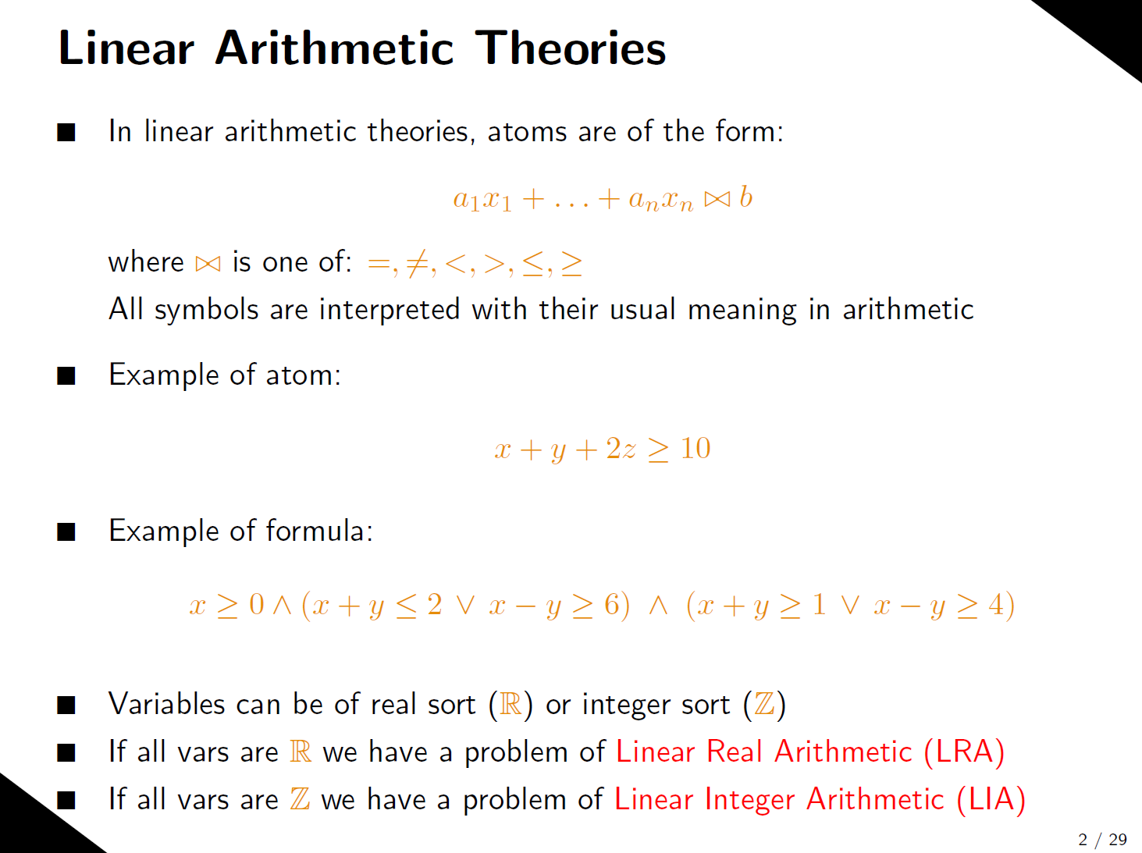

Slide 4
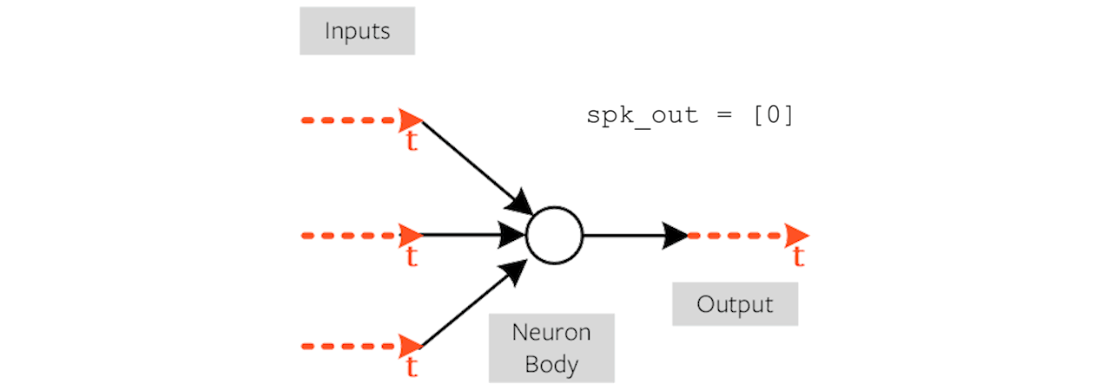
Spiking Neural Network

Slide 5
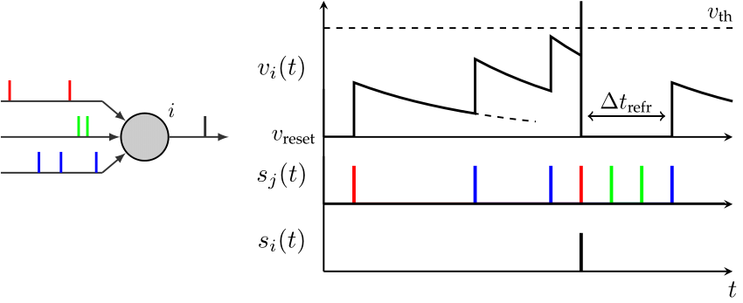
Leaky Integrate and Fire Neuron

Slide 6
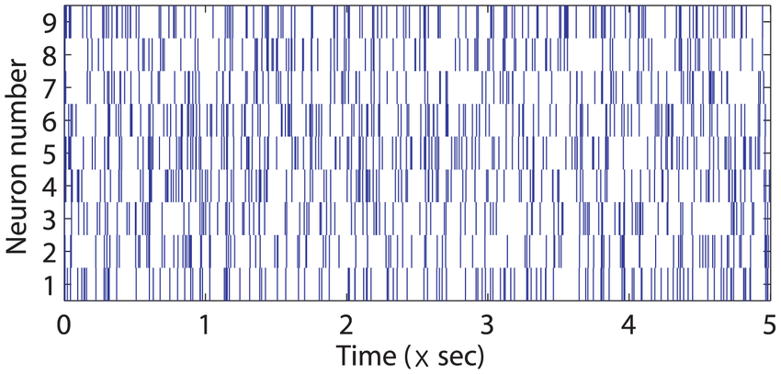
Complex Spike Train

Slide 7
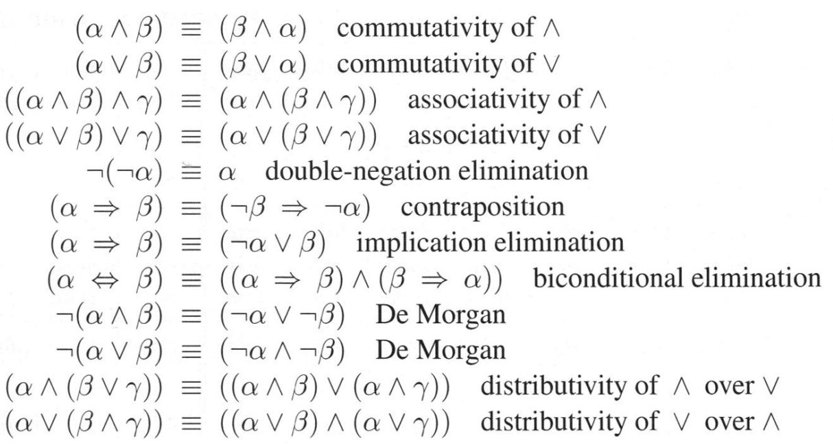
First Order Logic

Slide 8
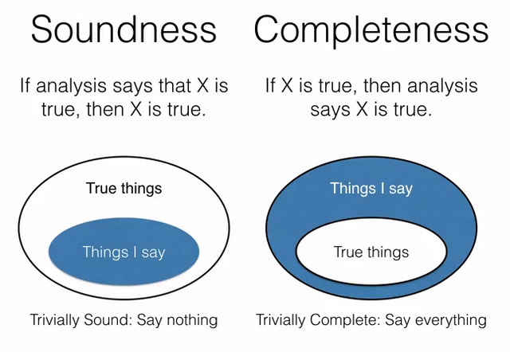
Soundness and Completeness

